Slide 1
MACHINE LEARNING ANALYSIS OF SPOTIFY TRACKS
FATHIMA KHENZA A

Slide 2
INTRODUCTION
Music is a daily essential for millions, and ‘Spotify’ is one of the most widely used music streaming platform worldwide.

Slide 3
Dual-Purpose Impact of Music Analytics
Popularity as a commercial indicator
Musical features as personalization tools
Helps artists and distributors understand what drives reach
Guides production, marketing and distribution decisions
Useful for building recommendation system and mood based playlist
Empower listeners to find songs they love

Slide 4
OBJECTIVE OF THE STUDY
To explore the relationship between key musical attributes.
To analyze the impact of audio features on song popularity.
To build predictive models for estimating track popularity.
To identify genre-based and feature-driven trends in music data.
To design a basic recommendation system using audio features.

Slide 5
DATASET OVERVIEW
Source: Kaggle
Size: 114,000 tracks
Total Columns: 21
Main Types of Data:
Audio Features: Tempo, Energy, valence etc.
General Info: Artist name, Track name, Genre, etc.
Target Variable: Popularity score

Slide 6
Key Audio Features
Tempo
Speed of the track in beats per minute (BPM)
Energy
Intensity and activity level of the track
Valence
Musical positivity or emotional brightness of a track
Acousticness
Speechiness
Presence of spoken words in a track
Instrumentalness
Probability that the track is instrumental, without vocals
Liveness
Likelihood that the track is acoustic (uses non-electronic instruments)
Detects the presence of an audience; higher values suggest a live recording

Slide 7
TOOLS USED IN ANALYSIS
Programming Language : Python
Notebook Environment : Jupyter Notebook

Slide 8
LIBRARIES
Numerical & Data Handling
NumPy
Pandas
Visualization
Matplotlib
Seaborn
Machine Learning & Modeling
Scikit-learn (sklearn)
Scipy
Statistical analysis

Slide 9
Statistical & Graphical Tools Used
Statistical Tools Used
Graphical Tools
Correlation Analysis
Mann-Whitney U Test
P-value Interpretation
Boxplot
Histogram
Scatter plot
Line Plot
Correlation heatmap

Slide 10
Key Analytical Techniques in Sequence
Random Forest
PCA
Clustering
Recommendation
Regression
Feature importance
Reduce mood features to 2D
Group songs by emotion
Emotion oriented
Feature similarity

Slide 11
DATA CLEANING
Prepared the dataset for EDA and pattern discovery

Slide 12
Removed 1 row with multiple missing values
Corrected invalid loudness values (e.g., positive dB → negative dB)
Replaced invalid time_signature values (e.g., 0 → 2)
Verified data types and logical ranges for features

Slide 13
Exploratory Data Analysis (EDA)
To understand the characteristics and underlying patterns in the dataset.

Slide 14
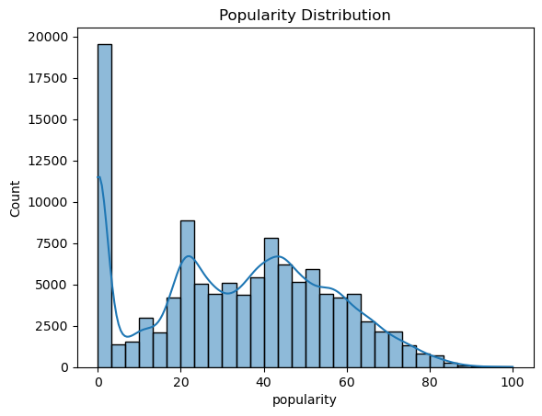
Popularity Distribution Histogram
The histogram reveals a high concentration of songs with very low popularity, while extremely popular tracks are relatively rare in the dataset.

Slide 15
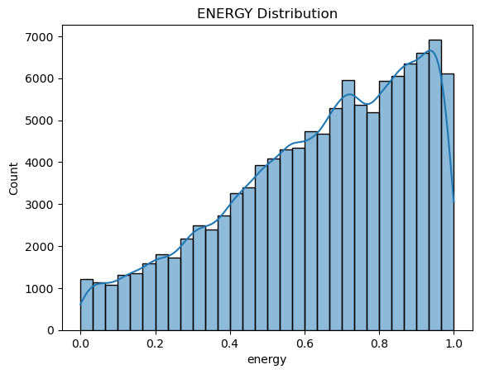
Energy Distribution Histogram
The plot revealed that the majority of songs tend to have higher energy values, indicating a general preference for more energetic music in the dataset.

Slide 16
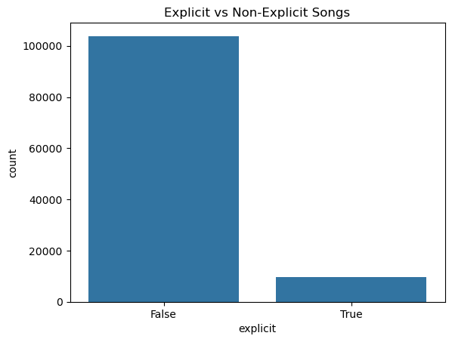
Explicit vs. Non-Explicit Tracks
The dataset is heavily dominated by non-explicit songs, with explicit tracks making up only a small portion.

Slide 17
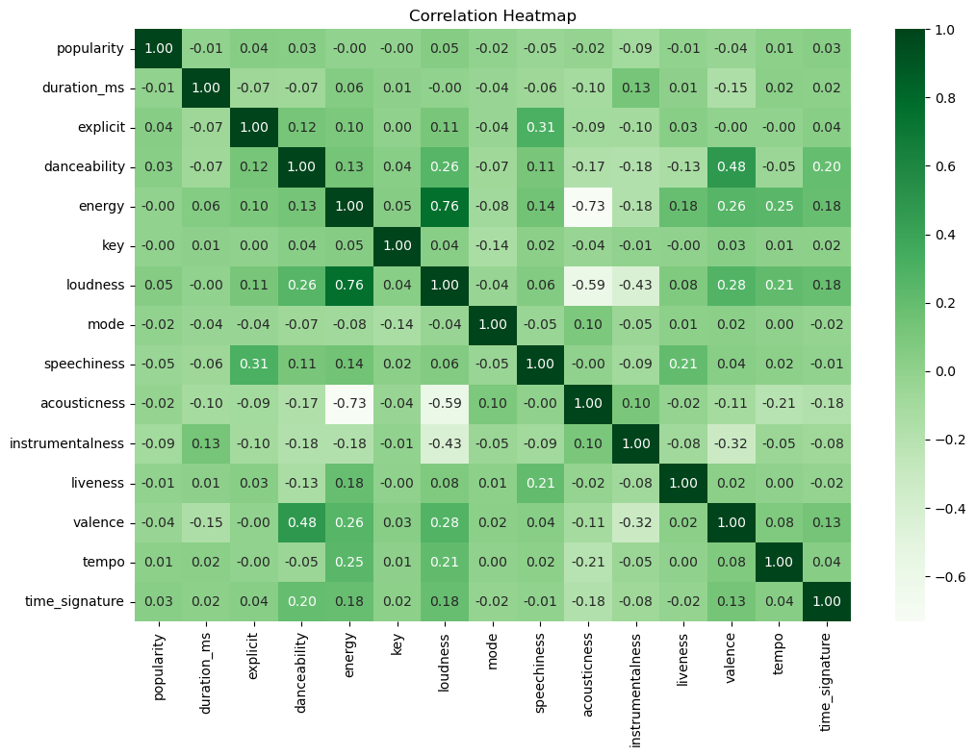
Correlation Heat Map
Most numerical features showed weak or

Slide 18
Insights from the Correlation Matrix
Most numerical features showed weak or negligible correlations.
Strong negative correlation was found between Energy and Acousticness.
Energy and Loudness exhibited a strong positive correlation

Slide 19
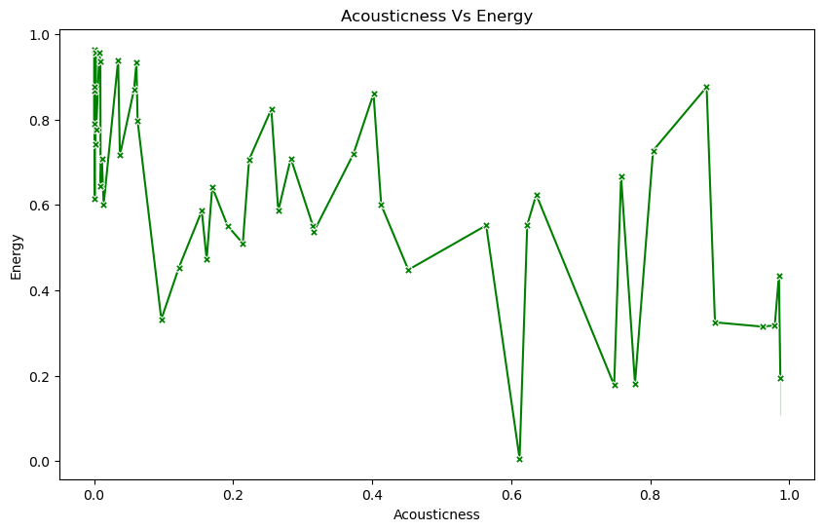
Acousticness vs. Energy Line Plot
The plot shows a generally negative but non-linear relationship between Acousticness and Energy, with noticeable fluctuations.

Slide 20
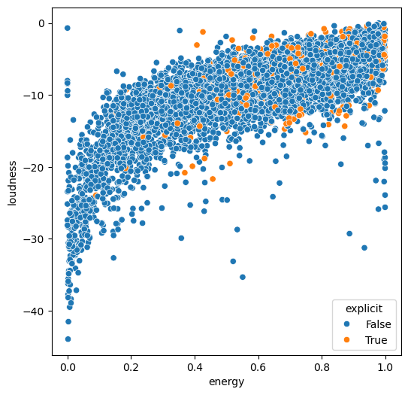
Loudness vs. Energy Scatter Plot
The scatter plot shows a general positive correlation between Loudness and Energy, with some exceptions where energy exceeds 0.7 despite loudness being below -20.

Slide 21
Genre-wise Distribution of High-Energy, Low-Loudness Tracks
TRACK GENRE | COUNTS
SLEEP | 99
WORLD MUSIC | 15
COMEDY | 2
BLACK METAL | 1
DETROIT TECHNO | 1
The Sleep genre dominates this exception cluster, accounting for 99 out of the total cases, while all other genres appear only marginally..

Slide 22
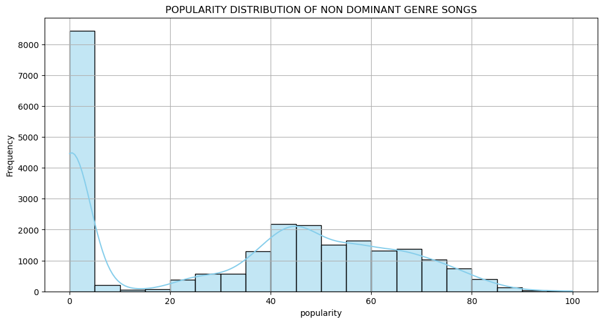
Popularity Distribution – Non-Dominant Genres
Non-dominant genres also show higher counts in lower popularity, reflecting the overall dataset
trend.

Slide 23
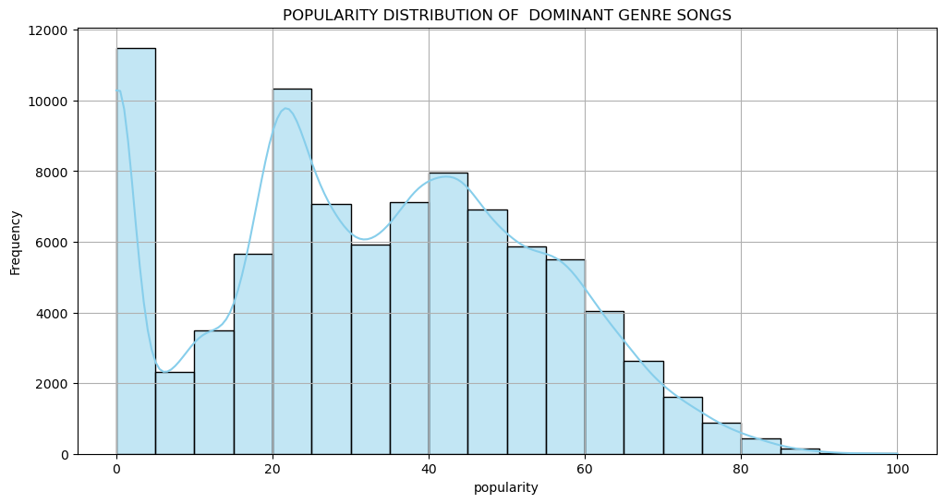
Popularity Distribution – Dominant Genres
Dominant genres show a noticeable increase in higher popularity ranges, indicating their stronger appeal among listeners compared to non-dominant genres.

Slide 24
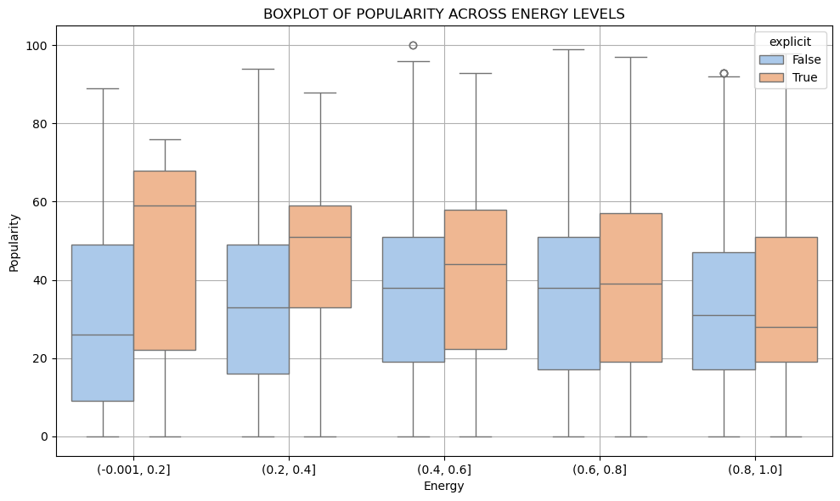
Box Plot: Popularity across Energy Levels
Explicit songs with low energy have greater variability in popularity, while higher energy levels correspond to a lower median popularity for explicit tracks.

Slide 25
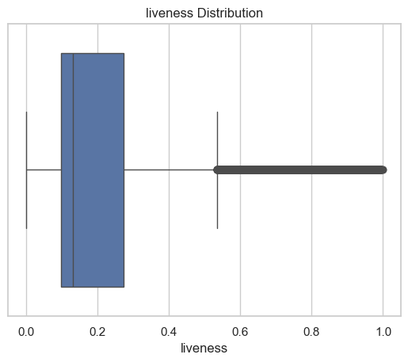
Liveness Distribution Box Plot

Slide 26
Inferences from Liveness Distribution
Heavily right-skewed; most values between 0.0–0.2
High-liveness outliers detected using IQR method
Outliers mostly from performance-based genres: – Comedy, pagode, sertanejo, samba
Suggests these tracks include live audience or ambient elements
Outliers are genre-driven, not random

Slide 27
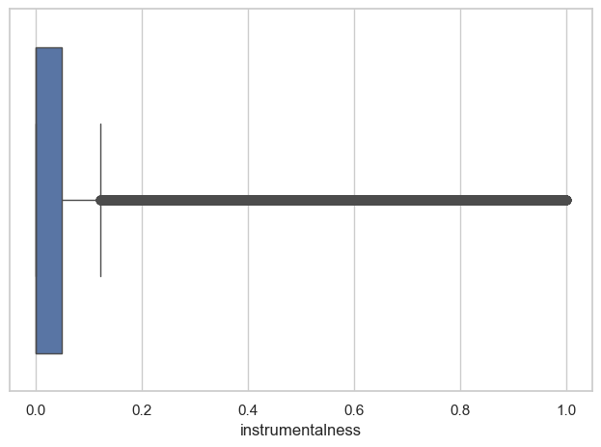
Box Plot: Instrumentalness Distribution

Slide 28
Inferences from Instrumentalness Distribution
Suggests tracks are either strongly vocal or purely instrumental
High outliers mostly from minimal techno, Detroit techno, sleep, new age
Instrumentalness is genre-specific, not random

Slide 29
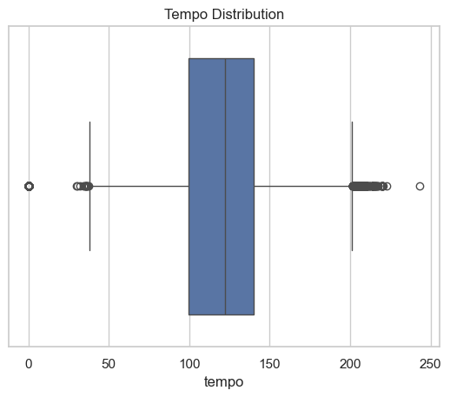
Box Plot: Tempo Distribution

Slide 30
Inferences from Tempo Distribution
Near-normal distribution; most tracks between 100–140 BPM
Peak around 130 BPM → common in pop, hip-hop, electronic
Reflects industry preference for danceable, listener-friendly tempos
Low outliers (< 40 BPM) seen in sleep/ambient genres
High outliers (> 200 BPM) in piano, rock, songwriter genres
Outliers highlight tempo diversity in expressive music

Slide 31
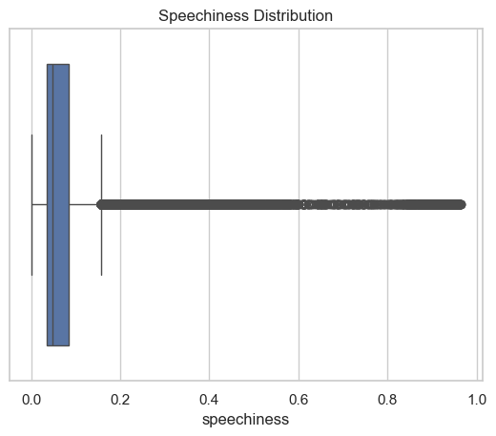
Box Plot: Speechiness Distribution

Slide 32
Inferences from Speechiness Distribution
Strong right-skew observed; most values < 0.3
Indicates dominance of sung/melodic vocals in mainstream tracks
Few tracks with speechiness > 0.66 — likely rap, spoken word, etc.
Outliers often from comedy, j-dance, dancehall, hardcore, and kids genres
Mid-range (0.4–0.66) is sparse → clear divide between musical vs. speech-based tracks

Slide 33
Statistical Hypothesis Testing
To assess whether explicit tracks differ in popularity compared to non-explicit ones
To determine whether a track’s musical mode (major or minor) influences its popularity

Slide 34
Popularity Differences by Explicit Content
H₀: There is no significant difference in popularity between explicit and non-explicit tracks.
H₁: There is a significant difference in popularity between the two groups.
p-value: 0.000 → ✅ Statistically significant
Inference: Explicit tracks have slightly higher mean and median popularity Suggests better listener engagement
Popularity Statistics by Explicitness
Track type | Mean popularity | Median popularity
Explicit | 36.52 | 37.5
Non-Explicit | 33.02 | 34

Slide 35
Popularity vs. Musical Mode (Major/Minor)
H₀: No difference in popularity
H₁: Significant difference exists
p-value: 0.000 → ✅ Statistically significant
Inference: Minor mode tracks slightly more popular than major mode ones
Popularity Statistics by Musical Mode
Track type | Mean popularity | Median popularity
Major | 33.07 | 34.0
Minor | 33.76 | 35.0

Slide 36
Data Preprocessing
To prepare the dataset for effective regression modeling, a series of transformation, encoding, and scaling techniques were applied.

Slide 37
Encoding: Label encoded explicit; target encoded artist name & track genre based on average popularity.
Scaling: Applied Min-Max Scaling to duration_ms, loudness, and tempo.
Train-Test Split: 80:20 split using train test_split() with random state = 42.
Feature Engineering: Yeo-Johnson transformation for popularity; created dominant vs. non-dominant genre label.

Slide 38
Regression Analysis Summary
To predict a track’s popularity based on its musical and metadata features

Slide 39
MODEL COMPARISON
Model | R² Score | MSE
Random Forest | 0.7788 | 110.95
Gradient Boosting | 0.7443 | 128.24
XGBoost | 0.7476 | 129.23
LightGBM | 0.7462 | 127.28
K-Nearest Neighbors | 0.6638 | 168.59
Best Model – Random Forest:
Achieved highest R² = 0.7788
and lowest MSE = 110.95
→ selected for final interpretation.

Slide 40
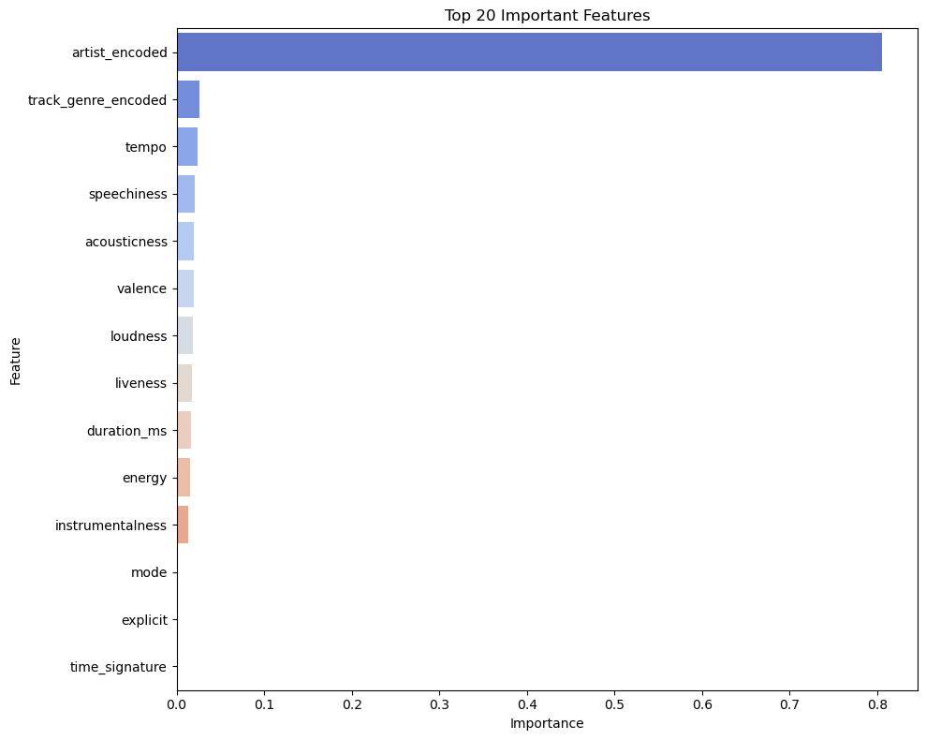
Feature Importance Analysis
Artist_encoded is the dominant feature (~0.80 importance)
track_genre_encoded, tempo, speechiness, acousticness, and valence contribute minimally
Features like mode, explicit, and time_signature had negligible impact and were excluded from the plot

Slide 41
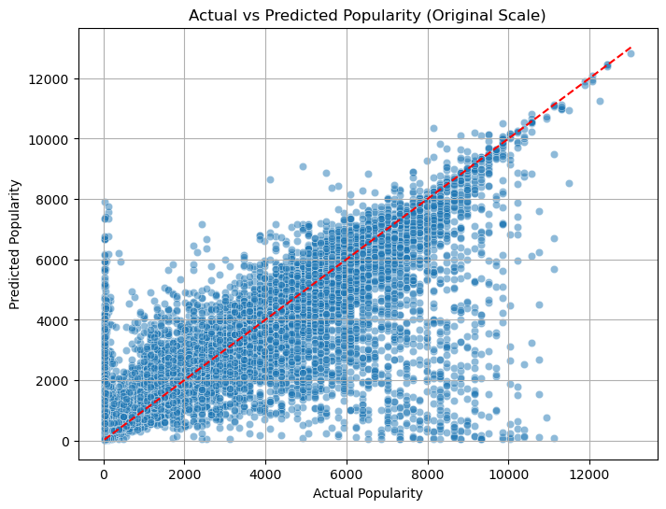
Actual vs. Predicted Plot
Residuals mostly centered around zero, indicating overall good fit
Wider spread at higher predicted popularity → more error on popular tracks
Suggests model performs better on less popular songs
Large residuals may be outliers influenced by external, unobserved factors

Slide 42
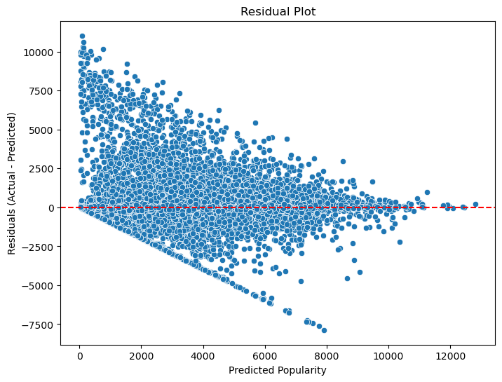
Residual Plot
Points align along the diagonal → decent prediction accuracy
High popularity tracks often underpredicted
Mid-range popularity shows slight overprediction

Slide 43
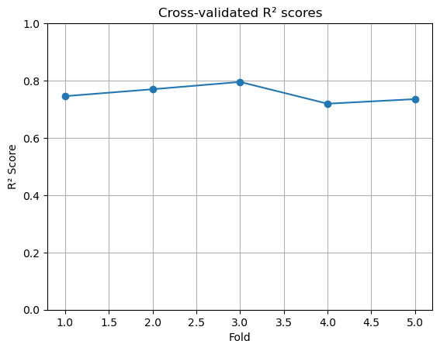
Cross-Validated R² Score
Stable and reliable model performance across data splits

Slide 44
Clustering
To uncover emotional groupings in the music dataset

Slide 45
Mood-Based Clustering
Performed K-Means clustering on mood features: valence, energy, acousticness, danceability, tempo, loudness
Formed 4 emotional clusters: Aggressive, Happy, Sad, Chill
Applied Principal Component Analysis (PCA)

Slide 46
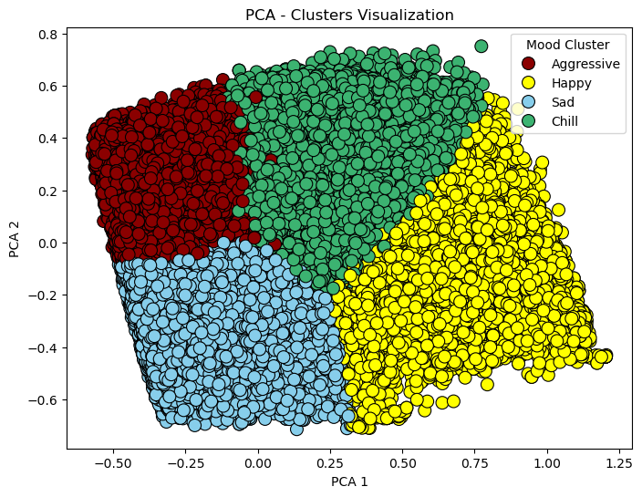
Cluster Visualization
Clear separation seen between mood clusters; some overlap exists
Aggressive cluster stands out (high loudness & energy)
Chill and Sad clusters are compact and low in energy/tempo
Happy tracks span mid-high energy & valence region
Silhouette score
= 0.405

Slide 47
Recommendation System
To enhance the practical application of the model

Slide 48
Mood-Based Recommendation
Similarity-Based Recommendation
Uses mood clusters from K-Means (Happy, Sad, Chill, Aggressive)
User selects a mood → system returns random songs from that cluster
Demonstrates emotion-driven song filtering
Uses cosine similarity on audio features (e.g., energy, valence, tempo)
Returns top 5 similar songs to a selected track
Shows potential for content-based music recommendations

Slide 49
Conclusion

Slide 50
SUMMARY
The project successfully explored how audio and metadata features affect Spotify track popularity.
Random Forest Regression was found to be the best-performing model, achieving an R² score close to 0.78.
Artist identity emerged as the most influential factor, followed by features like tempo, speechiness, and acousticness.
Statistical tests revealed that explicit content and musical mode (major/minor) have a significant impact on popularity.
Clustering analysis grouped songs into emotional categories like Aggressive, Happy, Sad, and Chill, supporting mood-based recommendations.
The results can help artists, producers, and streaming platforms understand listener preferences and improve content targeting.

Slide 51
Future Work
Enhance dataset using Spotify API (e.g., skips, saves, playlists, artist popularity)
Improve models with deep learning or advanced ensemble techniques
Add new features like lyrics, release timing, and artwork
Try better clustering (e.g., DBSCAN, GMM) for clearer mood separation
Develop recommendation system into a more interactive tool.

Slide 52
Strengths and Limitations

Slide 53
Rich audio features
Publicly available data
Missing user data
Popularity imbalance
External factors excluded
Weak feature correlations
Strong model accuracy
Stable cross-validation
Heteroscedastic residuals
Limited model tuning
Performance drop at extremes
Data & Features
Modeling Issues
Meaningful mood groups
Simple interpretable method
Cluster overlap
Subjective mood labels
K-Means assumptions
Basic recommender logic
No personalization
No hybrid filtering
Clustering
Recommendation

Slide 54
THANK YOU

